Slide 1
Intro to Machine Learning & Data Preprocessing
Session one
February 19, 2025

Slide 2

Who we are?

Slide 3




General Assembly!
West Hall - Auditorium A
@4:00 PM

Slide 4
Sessions Schedule
Week | Modules | Topics
19/02 @ 6:00 | Foundations of Machine Learning | Intro to ML + Data Preprocessing
26/02 @ 6:00 |  | Linear Regression
05/03 @ 4:00 |  | Classification
12/03 @ 4:00 |  | Kaggle Competition
19/03 @ 4:00 | Introduction to Deep Learning and Neural Networks | Perceptrons + Introduction to Deep Learning
26/03 @ 4:00 |  | Convolutional Neural Networks
05/04 @ 6:00 |  | Kaggle Competition

Slide 5





Meet the team
Sessions Lead
Hashem Khodor
hmk57
Razan Al Kakoun
rra65
Charbel Hannoun
cnh10
Shafik Houeidi
sah89
Ali Mansour
agm23

Slide 6




Stay Tuned!
Whatsapp
Discord

Slide 7
Now AI!

Slide 8

What’s the first thing that comes to your mind when you hear AI?

Slide 9
Today’s agenda:
Basics of Machine Learning
Different Data Types
Data pre-processing
Different Types of Supervised Learning
Hands on exercise

Slide 10

Basics of Machine Learning:

Slide 11
Types of Machine Learning:
Supervised Learning: Learning from labeled data. Examples: Spam detection, house price prediction, medical information.
Unsupervised Learning: Learning patterns from unlabeled data. Examples: Customer segmentation, anomaly detection.
Reinforcement Learning: Learning via trial-and-error in an environment. Examples: Netflix recommendation system, self-driving cars.

Slide 12
Data Preprocessing
Importance of Data Preprocessing: - Raw data has a lot of issues: missing values, outliers, inconsistent formats, …
Preprocess data using Pandas or Numpy:
https://www.youtube.com/watch?v=yAtzFLCWSZo https://www.youtube.com/watch?v=xECXZ3tyONo

Slide 13
Pandas Exercise
Read & inspect data: pd.read_csv(), .head(), .info()
Data manipulation: .groupby(), .apply(), .value_counts()
Data cleaning: lambda, .apply()
Analysis: Finding most-ordered items, total revenue, number of orders
Creating new Data Frames for further insights.

Slide 14
1. Data Loading & Creation
pd.read_csv(filepath_or_url, sep=',') → Load CSV/TSV file into a DataFrame
pd.read_excel(filepath, sheet_name='Sheet1') → Load Excel file
pd.read_json(filepath) → Load JSON file
pd.DataFrame(data) → Create a DataFrame from a dictionary, list, or array
pd.Series(data) → Create a Pandas Series

Slide 15
1. Data Loading & Creation
pd.read_csv(filepath_or_url, sep=',') → Load CSV/TSV file into a DataFrame
pd.read_excel(filepath, sheet_name='Sheet1') → Load Excel file
pd.read_json(filepath) → Load JSON file
pd.DataFrame(data) → Create a DataFrame from a dictionary, list, or array
pd.Series(data) → Create a Pandas Series
2. Data Inspection & Exploration
df.head(n) → Show first n rows (default 5)
df.tail(n) → Show last n rows
df.shape → Get (rows, columns)
df.info() → Summary of the dataset (columns, types, missing values)
df.describe() → Summary statistics (numerical columns)
df.columns → List all column names
df.index → Show DataFrame index
df.dtypes → Show data types of each column
df.nunique() → Count of unique values in each column

Slide 16
3. Data Selection & Filtering
df['column_name'] → Select a column
df[['col1', 'col2']] → Select multiple columns
df.iloc[row, col] → Select by index position
df.loc[row_label, col_label] → Select by label
df[df['column'] > value] → Filter rows based on a condition
df[df['column'].isin([val1, val2])] → Filter rows with specific values
df.query('column > value') → Query using a string condition

Slide 17
3. Data Selection & Filtering
df['column_name'] → Select a column
df[['col1', 'col2']] → Select multiple columns
df.iloc[row, col] → Select by index position
df.loc[row_label, col_label] → Select by label
df[df['column'] > value] → Filter rows based on a condition
df[df['column'].isin([val1, val2])] → Filter rows with specific values
df.query('column > value') → Query using a string condition
4. Data Cleaning & Manipulation
df.drop(columns=['col1', 'col2']) → Remove columns
df.dropna() → Remove rows with missing values
df.fillna(value) → Fill missing values
df.rename(columns={'old_name': 'new_name'}) → Rename columns
df.duplicated() → Check for duplicate rows
df.drop_duplicates() → Remove duplicate rows
df.astype({'col1': 'int'}) → Convert column to specific data type
df.replace({'old': 'new'}) → Replace values

Slide 18
5. Data Aggregation & Grouping
df.groupby('column').sum() → Group by and aggregate
df.groupby('column').mean() → Get average per group
df.groupby('column').count() → Count rows per group
df['column'].value_counts() → Count occurrences of unique values
df.pivot(index, columns, values) → Pivot table
df.melt(id_vars, var_name, value_name) → Unpivot DataFrame

Slide 19
5. Data Aggregation & Grouping
df.groupby('column').sum() → Group by and aggregate
df.groupby('column').mean() → Get average per group
df.groupby('column').count() → Count rows per group
df['column'].value_counts() → Count occurrences of unique values
df.pivot(index, columns, values) → Pivot table
df.melt(id_vars, var_name, value_name) → Unpivot DataFrame
6. Sorting & Indexing
df.sort_values(by='column', ascending=True) → Sort rows by column
df.sort_index() → Sort by index
df.set_index('column') → Set column as index
df.reset_index() → Reset index

Slide 20
7. Applying Functions & Transformation
df.apply(function, axis=0/1) → Apply function to rows/columns
df['column'].map(lambda x: x*2) → Apply function element-wise
df['column'].str.upper() → Convert text to uppercase
df['column'].astype(int) → Convert column type
df['column'].replace({'old': 'new'}) → Replace values

Slide 21
7. Applying Functions & Transformation
df.apply(function, axis=0/1) → Apply function to rows/columns
df['column'].map(lambda x: x*2) → Apply function element-wise
df['column'].str.upper() → Convert text to uppercase
df['column'].astype(int) → Convert column type
df['column'].replace({'old': 'new'}) → Replace values
8. Merging & Joining DataFrames
pd.concat([df1, df2]) → Concatenate DataFrames (vertical/horizontal)
df1.merge(df2, on='column', how='inner') → Merge DataFrames (inner, left, right, outer join)

Slide 22
7. Applying Functions & Transformation
df.apply(function, axis=0/1) → Apply function to rows/columns
df['column'].map(lambda x: x*2) → Apply function element-wise
df['column'].str.upper() → Convert text to uppercase
df['column'].astype(int) → Convert column type
df['column'].replace({'old': 'new'}) → Replace values
8. Merging & Joining DataFrames
pd.concat([df1, df2]) → Concatenate DataFrames (vertical/horizontal)
df1.merge(df2, on='column', how='inner') → Merge DataFrames (inner, left, right, outer join)
9. Exporting Data
df.to_csv('filename.csv', index=False) → Save DataFrame as CSV
df.to_excel('filename.xlsx', index=False) → Save as Excel
df.to_json('filename.json') → Save as JSON

Slide 23
Supervised Learning in Depth
What’s supervised learning?
Types of supervised machine learning:
Regression
Classification
Algorithms:
Linear regression
Logistic regression
K-Nearest Neighbors (KNN)
Decision Trees
Support Vector Machines (SVM)

Slide 24
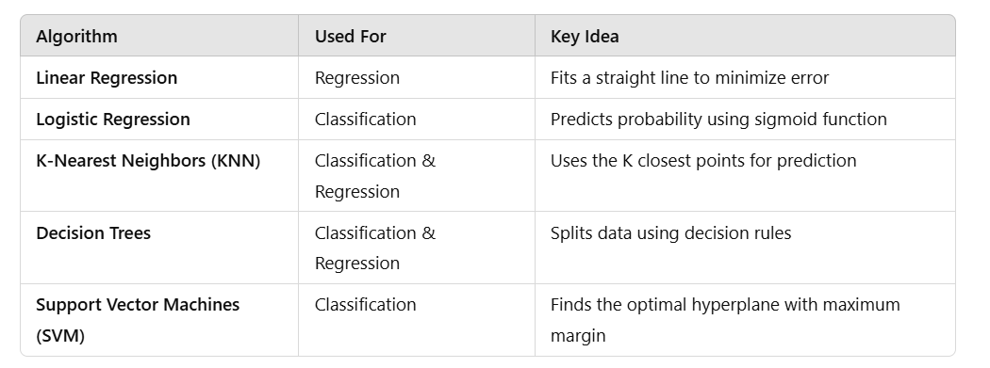
Summary of the algorithms

Slide 25
Hands-on exercise

Slide 26

Feedback Form

Slide 27
Useful links:
Pandas library: https://pandas.pydata.org/ Numpy library: https://numpy.org/

